Slide 1
Info Day - CEF Digital
29th November 2024

Slide 2
Priorities of the CEF Digital calls
Georgios TSELENTIS
Policy Officer,
Unit B.5, Investment in High-Capacity Networks
DG CONNECT, European Commission

Slide 3

CEF Digital fourth call for proposals:
Political context
The broad policy context for the CEF Digital WP 2024-27 remains
  The Digital Decade Policy Programme, supporting indirectly connectivity targets (Backbones and 5G) and iother objectives (e.g. edge cloud nodes).
  The White Paper “How to master Europe’s digital infrastructure needs?”, supporting the needed transformation of the telecom sector in line with the challenges described.
  The Recommendation on the security and resilience of submarine cable infrastructures, requiring to strengthen security and resilience of EU backbone connectivity within the EU and globally in a challenging geopolitical context.
  Deploying quantum infrastructure to enable ultra-secure communication between capitals

Slide 4
Building on lessons learnt
Simplify processes (e.g. security, approvals), but also ensure continuity
Review budgets and domains according to policy priorities.
Review max indicative amounts per grant, for instance for Global Gateways
Building critical mass (e.g. 5G LSP) in line with the White Paper

Slide 5
Overview of CEF-Digital calls 2024 (Call-4)
Calls | Topics | Budget (M EUR)
5G Large Scale Pilots | 5G large scale pilots - 5G Coverage along Transport Corridors CEF-DIG-2024-5GLSP-CORRIDORS-WORKS 5G large scale pilots - 5G and Edge for Smart Communities CEF-DIG-2024-5GLSP-SMARTCOM-WORKS | 105 (52.5 + 52.5)
Backbone connectivity for Digital Global Gateways | CEF-DIG-2024-GATEWAYS-WORKS CEF-DIG-2024-GATEWAYS-STUDIES | 128
EuroQCI | CEF-DIG-2024-EUROQCI-WORKS | 90
TOTAL |  | 323
Total Budget: 323 millions €
Notes:
-> expected to be increased! To be rev

Slide 6
Comparative budget for WP2 2024-27
 |  | CEF Digital implementing modes (2024-27)
Topic | Consumed 2021-23 (call 1, call 2, call 3 ) | Grant call (2024) | Blending Facility (2025-2027) | InvestEU Top Up (2025-27) | Total WP2 (2024-27)
5G Corridors | 100 | 105 |  | 100 | 205
5G Smart Communities (+ Edge Cloud) | 131
EuroQCI | 0 | 90 |  |  | 90
Cloud federations | 3.8 | - |  |  | -
Global Gateways | 433 | 128 | 384 | 30 | 542
Operational Digital Platforms | - | - |  |  | 20
Support Actions + procurement | 13.9 |  |  |  | 8
Total | 681.7 |  |  |  | 865

Slide 7
Digital Global Gateways
Georgios TSELENTIS
Policy Officer,
Unit B.5, Investment in High-Capacity Networks
DG CONNECT, European Commission

Slide 8


Backbone connectivity for Digital Global Gateways
5G Coverage along Transport Corridors
5G and Edge Cloud for Smart Communities
Join at
Slido.com
#CEFDigital
Georgios TSELENTIS
Investment in High-Capacity Networks
European Commission, DG CONNECT, Unit B5

Slide 9


“We will build Global Gateway partnerships with countries around the world. We want investments in quality infrastructure, connecting goods, people and services around the world.“
President of the European Commission, Ursula von der Leyen
State of the Union speech to the European Parliament, Strasbourg, 15 September 2021
White Paper – How to Master Europe’s Digital Infrastructure Needs – underpinning the Connected Collaborative Network vision:
Digital Infrastructure as an Economic Foundation
Addressing Connectivity Gaps and Market Disparities
Security and Resilience of Infrastructure
Supporting EU Digital Autonomy and Global Competitiveness
Sustainability and Technological Neutrality
Notes:
The Global Gateway Policy is the EU’s approach to supporting strategic connectivity that links Europe with global partners. Announced in the State of the Union speech by European Commission President Ursula von der Leyen in 2021, it seeks to build high-quality infrastructure that enables the free flow of people, goods, and services while enhancing digital resilience and security.
The white paper titled "How to Master Europe's Digital Infrastructure Needs" provides a broad policy context that aligns with the specific objectives of the CEF-DIG-2023-GATEWAYS call for proposals, which targets backbone connectivity under the EU’s Digital Global Gateways initiative. Here are some ways the white paper supports and contextualizes this call:
Digital Infrastructure as an Economic Foundation
The white paper underscores the importance of advanced, resilient digital infrastructures as essential for Europe’s economy, innovation, and competitiveness in the digital age. It stresses that a robust backbone network will underpin digital transformation across sectors like healthcare, energy, and transportation. This resonates with the CEF-DIG-2023-GATEWAYS call, which seeks to build a high-capacity digital backbone to support the EU’s economic security and digital economy by linking key connectivity points both within and outside the EU.
Addressing Connectivity Gaps and Market Disparities
The white paper highlights connectivity challenges in remote or underserved regions, including islands, rural areas, and outermost regions. Similarly, the CEF-DIG-2023-GATEWAYS call targets infrastructure projects that aim to reduce disparities in connectivity and support underserved regions, enabling equitable access to digital services. Both documents acknowledge that market forces alone may not address these needs, thus requiring strategic public funding.
Security and Resilience of Infrastructure
The white paper emphasizes the need for secure, resilient digital infrastructures, particularly considering recent geopolitical tensions. It discusses the risks of relying on non-EU suppliers and the importance of control over critical infrastructure. The CEF-DIG-2023-GATEWAYS call integrates these security considerations by requiring EU-controlled entities and compliance with EU cybersecurity guidelines, thereby ensuring that funded projects align with EU security priorities.
Supporting EU Digital Autonomy and Global Competitiveness
The policy paper advocates for EU digital sovereignty by reducing dependencies on external actors and enhancing Europe’s strategic autonomy. The CEF-DIG-2023-GATEWAYS call, by investing in infrastructure that connects the EU with key partners, supports this objective. These connectivity projects also aim to strengthen the EU’s global presence and partnerships in digital infrastructure, thereby contributing to Europe’s strategic autonomy and competitiveness.
Sustainability and Technological Neutrality
Sustainability is a recurring theme in the white paper, aligning with the EU’s green transition goals. It also supports a technologically neutral approach, allowing applicants to choose suitable technologies like submarine cables or satellite infrastructure to achieve connectivity goals in a sustainable way.
In essence, the white paper provides the broad strategic framework that justifies and supports the specific aims of the CEF-DIG-2023-GATEWAYS call, positioning it as a key component in the EU’s broader digital and geopolitical strategy. This alignment reinforces the EU’s commitment to secure, high-performance digital infrastructures that meet its economic, security, and sustainability goals.

Slide 10
Connectivity Ambition
2025 Gigabit Society Objectives
  100 Mbps to all households, upgradable to 1 Gbps
  1 Gbps to all main socio-economic drivers (schools, businesses, etc.)
  Uninterrupted 5G coverage in all urban areas and all major terrestrial transport paths
2030 Digital Compass Targets
  All European households will be covered by a Gigabit network
  All populated areas covered by 5G
Notes:
The initiative which aligns with the EU’s Global Gateway strategy, aims to provide secure, high-quality digital connections to foster economic development and digital transformation within Europe and with its international partners.
This connectivity is critical to achieving the EU’s 2030 Digital Decade goals of gigabit-speed internet access for all EU households and 5G coverage in populated areas.
A key aspect of the EU's Digital Decade targets for 2030 includes providing gigabit-speed internet access to all households and ensuring 5G coverage in populated areas. These ambitious targets underscore the need for a robust backbone infrastructure capable of handling increased data demand, enhancing connectivity within Europe, and supporting connections to non-EU regions.
Importance of Backbone Connectivity
Backbone networks are the high-capacity networks that serve as the core foundation of digital connectivity. They are essential for:
Resilience: Ensuring uninterrupted connectivity through multiple redundant pathways.
Capacity: Managing the growing volume of data traffic driven by digital services and applications.
Speed and Performance: Providing the infrastructure for high-speed internet and low-latency services, including 5G and future technologies.
Challenges and Needs in EU Connectivity
Disparities exist in connectivity access across EU regions, particularly in remote areas like islands, outermost regions, and overseas territories. These areas often face:
Higher costs and lower service availability, limiting their participation in the digital economy.
Aging or insufficient infrastructure, which affects resilience, especially during high-traffic periods or emergency situations.
The CEF-DIG-2023-GATEWAYS call aims to address these challenges by investing in infrastructure that connects underserved areas, ensuring the EU’s comprehensive digital connectivity.
Geopolitical Relevance
The EU’s focus on secure and resilient digital infrastructure has grown in response to recent geopolitical events, including the need for secure connections with countries like Ukraine and Moldova, which have recently joined the CEF program.
Strategic partnerships with countries such as Japan also emphasize the EU’s commitment to resilient infrastructure through projects like secure submarine cables.

Slide 11
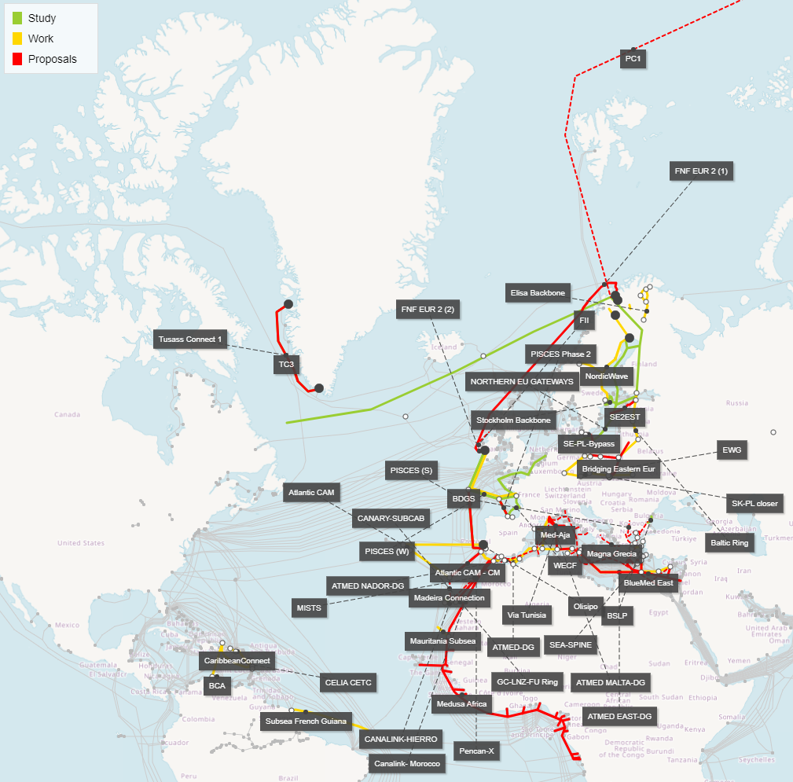

Digital Global Gateways
CEF past Call Results*
* pending Call-3 projects signature finalisation
Notes:
So far, with the three first calls we have reached a significant footprint in connecting EU within its MS and with 3rd countries

Slide 12
Backbone connectivity for Digital Global Gateways
CEF-DIG-2024-GATEWAYS-STUDIES & …WORKS
Objective
Support the deployment of strategic networks as part of the Digital Global Gateway Strategy of the EU.
CEF Digital will support the deployment of backbone networks addressing connectivity needs, such as:
Connecting all territories of the EU including its Outermost Regions.
Supporting the specific needs of Member States which are islands themselves or have islands as part of their territory.
Intermeshing backbones interconnecting major points of connectivity in the EU.
Addressing the specific needs of Overseas Countries and Territories in the EU.
Ensuring international connectivity to EU partners worldwide as a basis for European strategic autonomy.
Promoting synergy projects addressing other objectives of CEF Digital, including sector specific considerations encompassing the connectivity of large-scale digital capacities such as HPC or cloud.
Notes:
The Connecting Europe Facility (CEF) Digital program is an EU initiative that aims to support the development of high-performance, secure, and sustainable digital infrastructures across Europe. CEF Digital focuses on strengthening cross-border digital connectivity and integrating digital infrastructures to support the EU’s digital economy.
Primary Objective: Enhance Backbone Connectivity
The core goal of the CEF-DIG-2023-GATEWAYS call is to improve digital backbone connectivity across the EU and with key global partners.
By enhancing connectivity infrastructure, this initiative aims to provide a secure, resilient digital backbone that supports the EU's strategic goals for digital connectivity and autonomy.
Strengthen EU Digital Infrastructure and Resilience
Improve the quality and reliability of connectivity networks within the EU, especially for remote and underserved regions such as islands, outermost regions, and overseas territories.
Establish new or upgraded backbone infrastructure, including submarine cables, satellite stations, and other high-capacity connectivity solutions to address regional disparities in connectivity.
Expand Global Digital Partnerships
Facilitate secure and resilient digital links between the EU and strategic third countries, enhancing the EU’s digital autonomy and global digital footprint.
Provide high-capacity, low-latency connections to bolster trade, research, and security alliances with partner countries globally.
Support for Market Gaps and Redundancy
Address market failures in areas where commercial investment alone does not meet connectivity needs, especially in underserved or high-cost regions.
Increase network redundancy, ensuring multiple connectivity pathways to safeguard against network outages and geopolitical risks.
Technological Neutrality and Innovation
The call encourages proposals that present innovative solutions and are technology-neutral, allowing applicants to justify the most effective technology for each project, whether through submarine cables, satellite infrastructure, or advanced networking solutions.
Encourage the adoption of secure and sustainable technologies that align with EU cybersecurity and environmental standards.

Slide 13
Backbone connectivity for Digital Global Gateways
CEF-DIG-2024-GATEWAYS-STUDIES & …WORKS
Technology neutral call
Digital Global Gateways can be provided with the technology best suited including e.g.:
Submarine Cable Systems,
Satellite Infrastructure,
Connectivity to internet exchange points, and
Inter-Connection of Backbones with networks inside of the supported territories
What will be co-financed
For works, total project costs required to construct and deliver the described networking solution for the foreseen system lifetime, from end to end, including cable landing station and connectivity towards them. Operating costs, and costs for the land ownership excluded.
For studies, all preparatory work required prior to signing a contract with a supplier such as marine ground surveys for submarine cables, and the application for required permits.

Slide 14

Backbone connectivity for Digital Global Gateways
CEF-DIG-2024-GATEWAYS-STUDIES & …WORKS
Expected Impact:
benefits go beyond those directly related to supported projects
contribute to bridging the digital divide,
ensuring widespread access to gigabit networks
for everybody in the EU and all businesses.
This connectivity infrastructure can cross-facilitate the implementation of other topics supported under CEF Digital, such as the
take-up of 5G connectivity, High Performance Computing, etc.
Maximum Co-Funding Rates:
Works: 30%
Strong Cross-border Dimension: 50%
Outermost Regions: 70%
Studies: 50%

Slide 15
Business plan financial spreadsheet
CEF-DIG-2024-GATEWAYS-WORKS
Its purpose is to help applicants demonstrate the market failure and assess the effect of the EU financial assistance.
It is an admissibility condition only for proposals including Works.
The Excel template is available in the Submission System and is password protected. Only the input cells/sheets can be modified. Two Free Tabs are available for intermediate calculations. All instructions are detailed in the “Notice” sheet
The Financial Discount rate (net of inflation) is prefilled at 5%. If this hurdle rate is not adapted to the project at stake, it can be modified but the new rate must be justified (e.g. with a WACC calculation).

Slide 16
Backbone connectivity for Digital Global Gateways
CEF-DIG-2024-GATEWAYS-STUDIES & …WORKS
Call 4:
Open 22 Oct 2024
Deadline 13 Feb 2025 17:00 CET
Budget 128 MEUR combined for studies and works
Maximum requested grant for works 20 MEUR, for studies 5 MEUR
Exceptional cases up to 60 MEUR. To be justified by applicant
(see section 6 eligibility in the call text)
This is a competitive call
It needs to be supported by the relevant Member State(s)
URL works
URL studies
Notes:
Key evaluation criteria: Priority, Maturity, Quality, Impact, Catalytic Effect
The 128€ is a total
The call is competitive between both studies and works
In exceptional cases, proposals combining complementary projects, which may come from different promoters, to achieve a greater geographical reach and avoid overlapping segments may benefit from a higher grant amount, not exceeding however m€ 60. This would need to be justified through a greater impact (e.g. substantially higher geographical scale, etc.) and catalytic effect (e.g. synergy between different promoters resulting in substantial cost-efficiency gains). The grant awarded may be lower than the amount requested.

Slide 17
5G Large Scale Pilots
Bianca JITEA
Policy Officer,
Unit E.1, Future Connectivity Systems
DG CONNECT, European Commission
Amalia LEBU
Programme Assistant - EU Policies,
Unit B.5, Investment in High-Capacity Networks
DG CONNECT, European Commission

Slide 18
5G Large Scale Pilots
5G Coverage along Transport Corridors
5G and Edge Cloud for Smart Communities
Join at
Slido.com
#CEFDigital
Amalia LEBU
Investment in High-Capacity Networks
European Commission, DG CONNECT, Unit B5

Slide 19



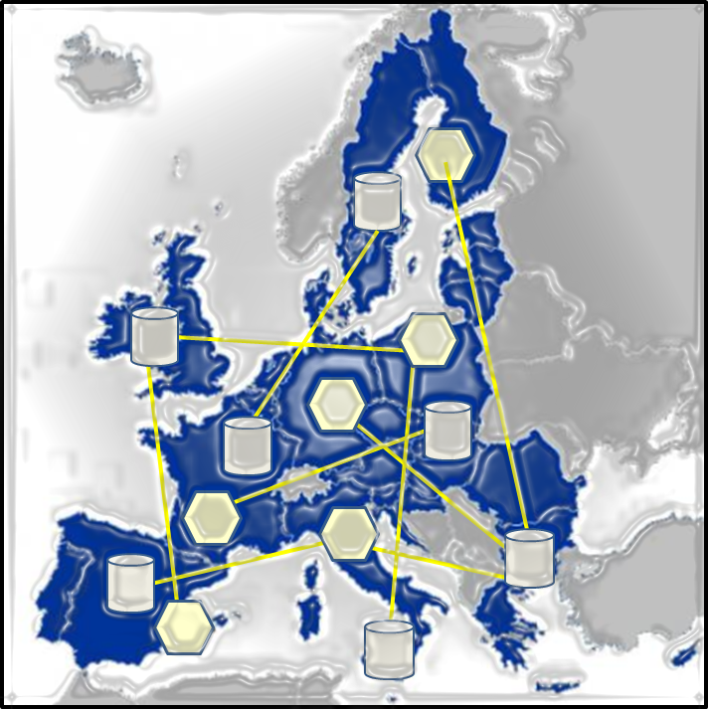



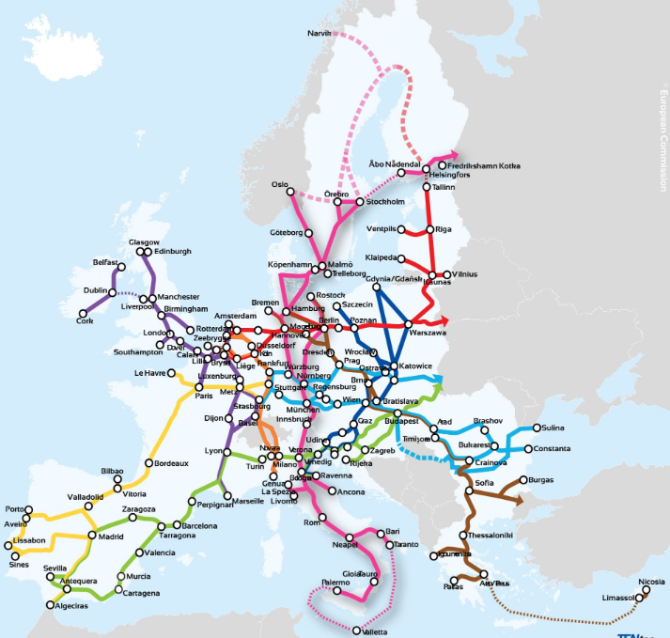

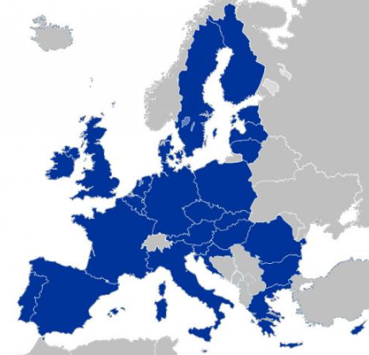
5GLSP – Key drivers and strategic vision
White Paper – How to Master Europe’s Digital Infrastructure Needs – underpinning the Connected Collaborative Network vision
Supporting the EU Digital Decade policy targets: 5G in all populated areas, Gigabit connectivity to all households
Fostering EU competitiveness: bundling connectivity with edge cloud to support innovative use-cases, stimulus to EU digital supply, new business models for telcos
Contributing to EU digital sovereignty: 5G toolbox, EU controllership, trusted suppliers
Verticals
AI
Data
Virtualised infrastructures and platforms
HPC
Cloud
QCI
Connectivity infrastructure
(Backbones, 5G/Gigabit…)

Slide 20
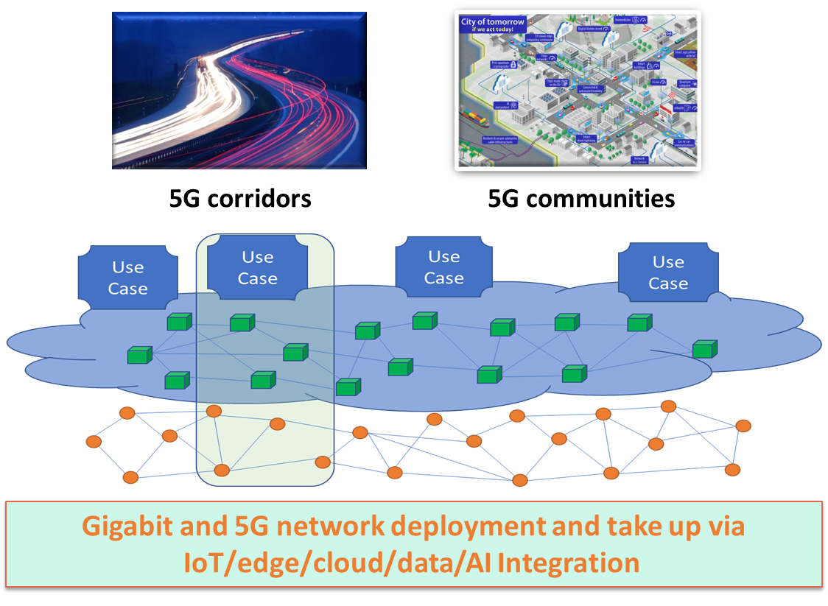
5G large scale pilots to advance the “3C Network”
Deploying 5G standalone connectivity, underpinning the 3C Network ecosystem (Connected, Collaborative, Computing)
Rationale
Alignment with the “3C network” narrative of the White Paper
Speed up the deployment and take-up of standalone 5G systems
Integration of device, network, cloud and edge computing, and communication capabilities
Demonstrate the benefits, in concrete use cases, of the evolution towards virtualised and cloud-native network functions and distributed telco edge cloud

Slide 21
5G large scale pilots to advance the “3C Network”
Definition
Objectives
Scope
  The combined deployment and take-up of 5G standalone networks (5G SA)
  including their integration with edge computing capacities,
  that meet the requirements of innovative use cases in terms of very-high reliability, security, low latency, communication symmetry, and high throughput
  5G SA connectivity and computing continuum to be deployed along major terrestrial transport routes
  5G SA deployment to improve the connectivity used to support the activities of socio-economic drivers (SEDs)
  Deploy large-scale 5G SA infrastructures that integrate connectivity and edge cloud capacities along the 3C Network value chain
  Stimulate wider and faster deployment and take-up of 5G
  Demonstrate the benefits gained in specific application
  Leverage the 5G infrastructure
  Promote replicability and best practices
  Deployment of 5G SA infrastructure
  Relevant connectivity elements, required to implement innovative use-cases targeting either 5G corridors or 5G smart communities (e.g. edge capacity)

Slide 22
5GLSP
5G Coverage along Transport Corridors
Join at
Slido.com
#CEFDigital
Bianca JITEA
Policy Officer, Future Connectivity Systems
European Commission, DG CONNECT, Unit E1

Slide 23
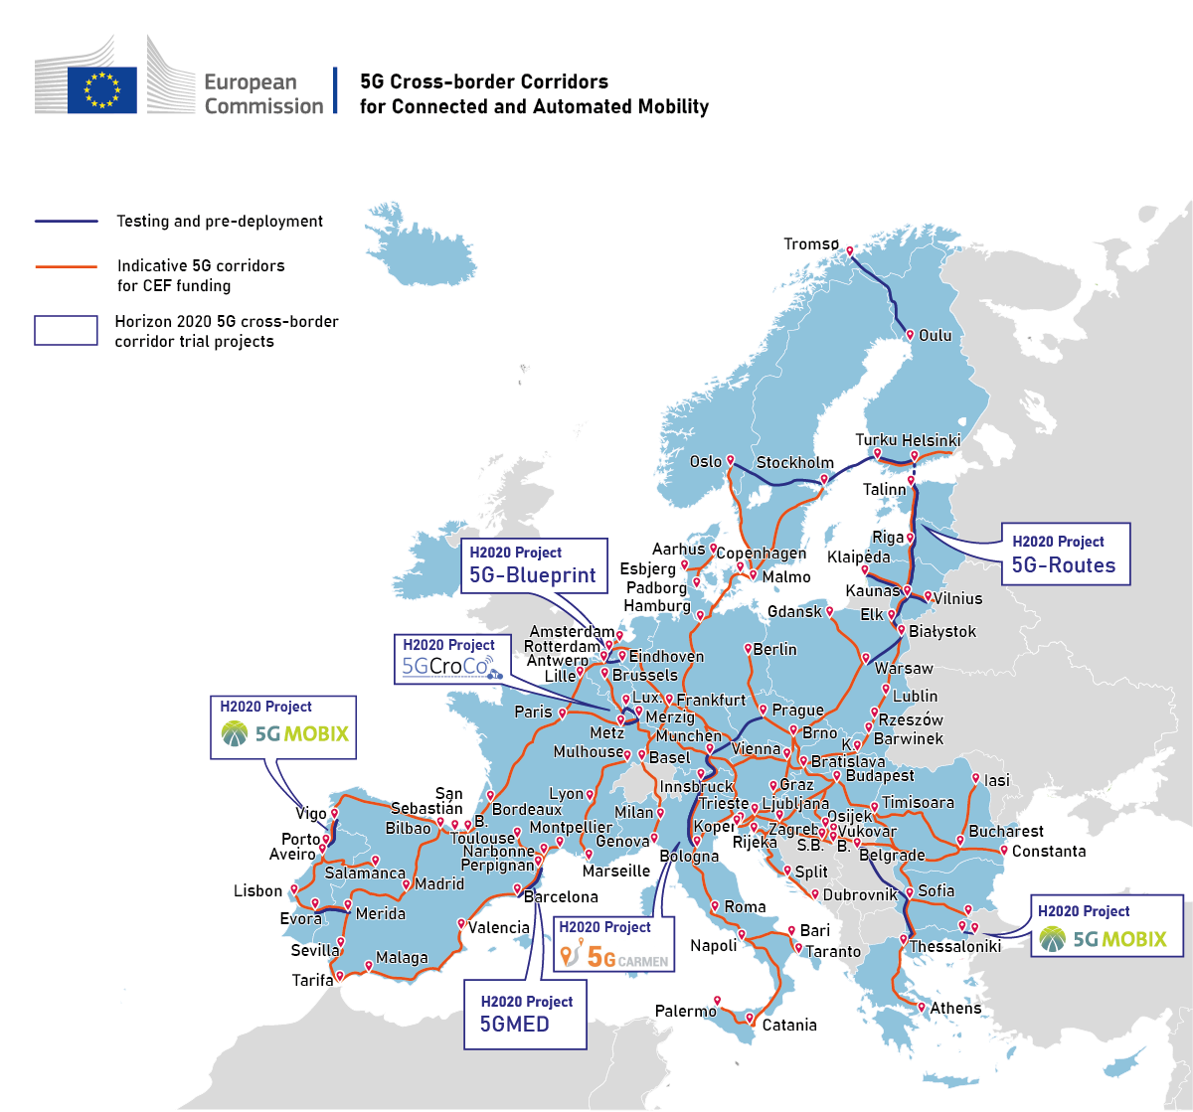
5G Corridors: a driving force behind the EU Green and Digital Transition
Digital Decade: Pan-European deployment of 5G corridors along TEN-T network for road, rail, waterways
Massive investments required for a fully-fledged TEN-T 5G corridor deployment > EUR 25-79 bn
Lessons learnt from Horizon 2020 cross-border large-scale trials projects
Priority sections of TEN-T corridors identified in CEF Regulation: 26,000km in length, 49 intra-EU borders
CEF Digital WP1, budget spent: EUR 93MM (3 calls) 2021-23
CEF Digital WP 2: EUR 205 million 2024-27 for 5G, adopted in October 2024 (Corridors & Smart Communities)
Guidance coordinated by the SNS JU, based on 5G Strategic Deployment Agenda Road and Rail
Notes:
2nd bullet: the broad range of estimates for investment required, based on a WIK study commissioned by B5, depends on network sharing options, and these figures include coverage obligations from 5G licences anyway (ie actual investment needs for corridor deployment to fill-in the gaps where there is no infrastructure at all - e.g. sparsely populated areas- and to enhance the radio density required for CAM QoS)
3rd bullet: we are not starting from scratch, 5G cross-border trial projects (in boxes on the map) have successfully demonstrated service continuity across the border for CAM, rail and waterways/ports
4th bullet: Priority sections identified under CEF Regulation appear in red lines on the map and represent only a fraction of the overall TEN-T corridors – the reference to the initial 800MM planned for the 2021-2027 period has been removed because we’ll meet only 20% of it..

Slide 24



CEF-Digital Programme: 2021-27
5G
Backbones
Work Programme 1: 2021-23, € 682 MM budget was foreseen
Budget consumption based on Calls 1,2, 3 (Call 3 results still under grant agreement preparations)
5G for
Transport Corridors
Digital Global Gateways
Operational Digital Platforms
25 projects, € 93 million
51 projects, € 420 million
Call in 2025
5G & Edge Computing for
Smart Communities
Quantum Communication Infrastructure
Support Actions
41 projects, € 126 million
Call postponed to 2024
3 projects, € 7 million
Work Programme 2024-27: € 865 million
Note: Call 3 results are indicative and will only be official once Grant Agreement Preparations final, by 12/2024
Notes:
FYI - this slide now includes call 3:
The CEF Digital Programme covers both 5G topics, as well as Backbones, Digial Platforms and support actions
93MM € spent to date during the 3 calls and a total of 25 projects (18 have already launched& are ongoing (50% subscription rate vs. Planned budget due to lack of market maturity and clarity onreturn on investment on the part of the private sector )
Calls 1& 2, 18 projects were launched in 2023 and 2024, respectively for a total grant request of 42 MM €
Call 3 generated another 7 projects, thus bringing the total number of projects up to 25 for a total grant request of 93 MM €

Slide 25
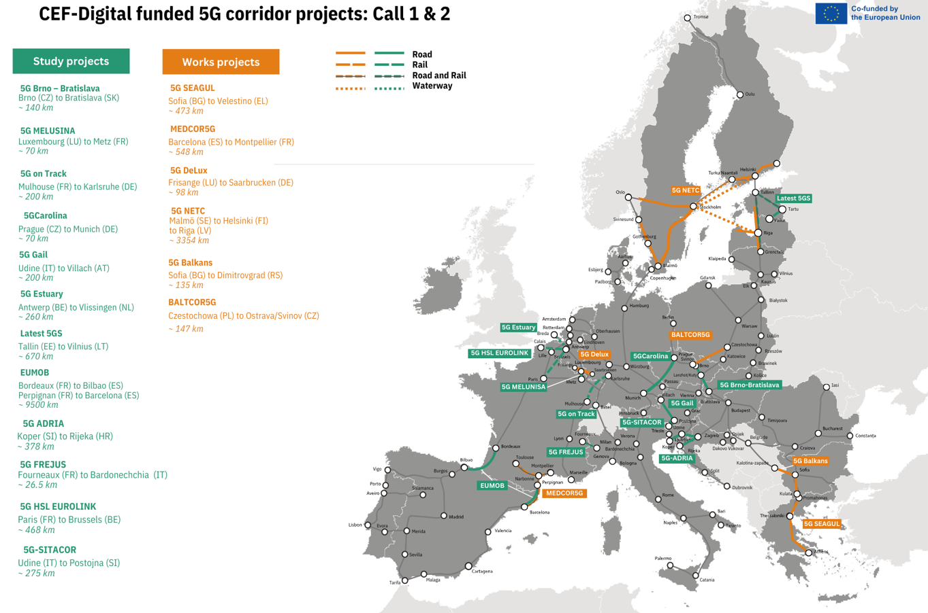
Launched: Call 1&2 projects
18 projects: 12 studies & 6 works
                A good mix of road, rail and maritime projects
                Predominance of studies over projects
                Different trends/business models are developing
EU grants requested = € 42.3 M
Total cost = € 99.6 M
Length of deployed 5G corridors covered: 4252km
Number of intra-EU borders covered: 19
Up to 50% co-funding
Notes:
This an overview of ongoing projects that launched as a result of calls 1 & 2 & spending to date
As expected, during these first two calls we saw more inception studies being undertaken than deployment projects
You can see that the deployed projects span accross 4252km and are covering 19 intra-EU borders, important to mention as these are the main KPIs used to assess deployment

Slide 26
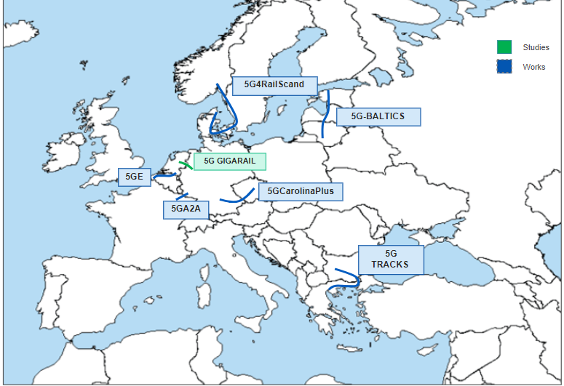
Ongoing: Call 3 proposals undergoing GAP
7 projects: 6 works, 1 study​​​
                4 Road projects (EU contribution € 28 million​)
2 Rail projects (EU contribution € 19 million)
1 Waterway/Maritime project (EU contribution € 3.7 million)
Predominance of works projects
Total EU contribution: € 51 million
up to 50% co-funding
Connections shown are approximate
Call 3 projects are still under grant agreement preparation and could be subject to change
Notes:
The number of projects are indicative but should be confirmed by end of year at the latest, once GAP preparations are finalised
As opposed to previous calls, the majority of projects are deployment projects (vs. Studies), which is a natural evaolution from inception studies towards actual deployment
The market took a while to come around and mature around but expectedly so; we hope to see this momentum continue in Call 4

Slide 27
5G Corridors: Call 4 → focus on 5G LSPs
Focus shift on to 5G Large Scale Pilots → 5G stand-alone integrated with edge computing facilities
  Alignment with the Connected Collaborative Computing narrative of the White Paper on Europe’s Digital Infrastructure*
5G Corridors and 5G for Smart Communities regrouped under the 5G LSP umbrella, but separate topics
Proposals for deployment works based on previous CEF-funded inception studies conducted as part of Calls 1 and 2
New deployment work proposals based on preparatory work done outside of the CEF-Digital Work Programme
5G Corridors EU Grant: ~ 52.5 million € (estimated)
Up to 50% co-financing
*White Paper on ‘How to master Europe's digital infrastructure needs?’
Notes:
The second WP for the 24-27 time period was recently adopted on 9 October 2024
everything that was possible under the 1st WP still stands and is still feasible
The main change for 5G Corridors rests in the fact that the focus is now 5G LSP, defined as 5G stand-alone integrated with edge computing facilities
WP2: 5G LSP include both 5G corridors and 5G smart communities
What the LSP actually mean according to White Paper:
bundle 5G standalone deployment with edge cloud capabilities, alongside integration with vertical use cases
Deploy larger scale pilot projects along transport corridors for CAM use cases, including rail and waterways, but also open to other innovative use cases
Rationale behind shift in focus
To align with White Paper narrative
Integration of device, network, cloud and edge computing, and communication capabilities
Showcase the benefits, in concrete use cases, of the evolution towards virtualised and cloud-native network functions and distributed telco edge cloud
More info on Security Provisions
Eligibility of beneficiaries: EU controlled entities; possibility (except for QCI) to accept non-EU controlled entities if they submit security guarantees
Security guarantees:
a) control over the applicant is not exercised in a manner that restrains, or restricts in any way its ability to perform and complete the action
b) applicant is not subject to non-eligible third country jurisdiction obligations that may undermine the security of the Union
c) the results of the action will remain within the beneficiary and will not be subject to control or restrictions by non-eligible third countries/ entities during the action and for a specified period after its completion (10 years).
Equipment: subject to 5G toolbox + Communication of 15 June 2023

Slide 28

Objectives
    Leverage the needed private investment to establish a full pan-European road and railway network of 5G corridors, with a focus on cross-border sections
    Deploy 5G systems along transport paths thus enabling Connected and Automated Mobility (CAM), including automated rail and waterway operations
    Uninterrupted coverage with 5G systems across all major European transport paths, following but not limited to TEN-T corridors (indicative list in Part V of CEF Regulation Annex)
    Uninterrupted coverage for: CAM, FRMCS, RIS and multi-service application of 5G services, including non-safety services
    Transport modes: rail, road, inland waterways and/or a multimodal combination thereof (example: smart logistics use cases in multimodal logistics platforms and ports, etc.)

Slide 29
Consortium Composition
    Minimum 2 applicants (beneficiaries, not affiliated entities) from at least 2 Member States or a Member State and an associated or third country
    Exception: minimum 2 applicants (beneficiaries, not affiliated entities) from at least one Member State - when there is no terrestrial border with another Member State - 5G corridor deployment projects crossing the border of a 3rd country or terminating at a port with maritime connections to other EU Member States
Notes:
Exception introduced

Slide 30
Possible Consortium Members
    5G spectrum band owners / telecom operators
    Tower companies
    Public authorities / agencies in charge of traffic and infrastructure management
    Road operators
    Rail infrastructure managers
    Original equipment manufacturers
    Mobility service providers (such as innovative solutions providers for traffic management and intelligent transport systems)

Slide 31
Scope
Scope | Works
Cross-border (50% funding)
Intra-national if insufficient mobile coverage for CAM or without 4G coverage (30% funding)
Coexistence with ITS-G5, FRMCS and RIS - compatibility analysis
Road, rail, inland waterways, multimodality (i.e., logistics)
Installation of active network elements (routers, switches, antennae, MEC edge nodes, etc.)
Installation of passive network elements (ducts, dark fibre, 5G radio stations, etc.)
Installation of specific track side devices (sensors, cameras for traffic monitoring incl. roadside units)
Studies for preparatory works, including network planning (50% funding) | If necessary for the works deployment in the same proposal
Location, length | 15% TEN-T

Slide 32
Requirements
Requirements | Works
Security declarations
Ownership Control Questionnaire
Market failure declarations from the coordinator indicating no other 5G infrastructure present or credibly planned
MNO declarations - beyond coverage obligations
Other: please check carefully admissibility requirements!

Slide 33

5GLSP
5G and Edge Cloud for Smart Communities
Join at
Slido.com
#CEFDigital
Amalia LEBU
Investment in High-Capacity Networks
European Commission, DG CONNECT, Unit B5

Slide 34

5G and Edge for Smart Communities
CEF-DIG-2024-5GLSP-SMARTCOM-WORKS: 5G large scale pilots 5G and Edge for Smart Communities – Works
Funding
Objectives
Call-4: 52.5 million euros
Deployment of 5G and Edge infrastructure elements that enable innovative use-cases for socio-economic drivers
3C Network Alignment: Contribute to the Connected Collaborative Computing (3C) Network by transitioning to virtualised and cloud-native infrastructure
Innovation Support: Enable new operational models, social innovation, and business models within European vertical sectors

Slide 35
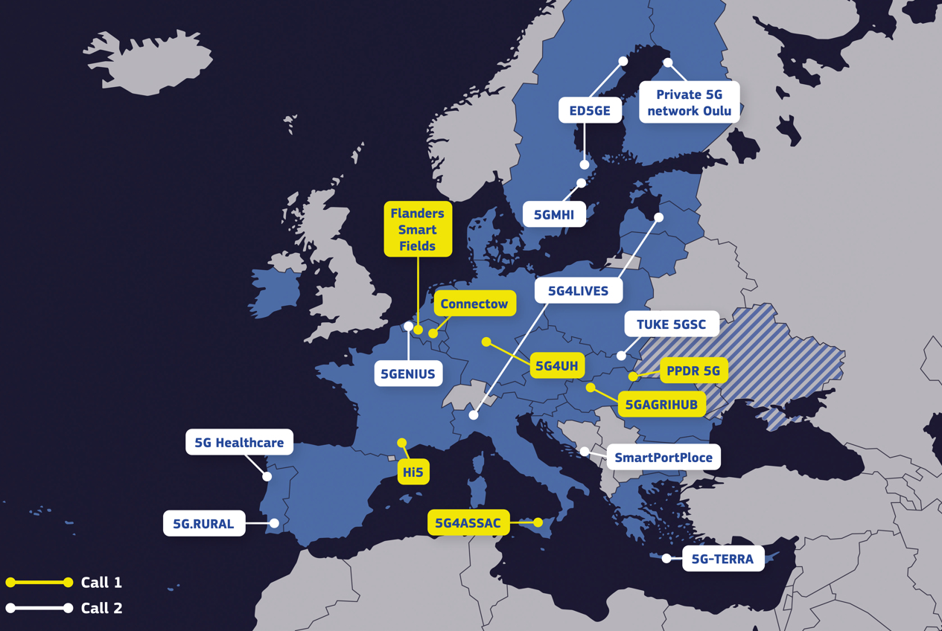
5G and Edge Cloud for Smart Communities – Call 1 and 2
5GSC
17 Projects
€ 57.8 M grants
Numerous use cases
Wide EU coverage
Project Directory

Slide 36
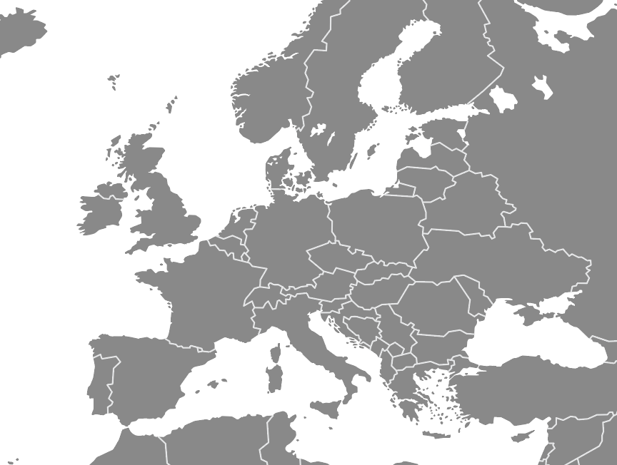
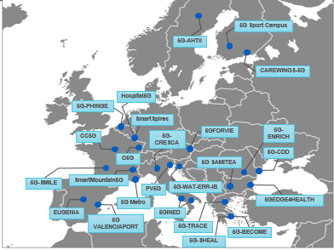

5G and Edge Cloud for Smart Communities
Call 3 Under GAP
5GSC
25 Projects
€ 81 M grants
Facilitating an online community for stakeholders (5GSC.EU)

Slide 37
5GSC Call-1 -2 -3 trends
From projects’ portfolio
  Public Operators - Alternative Operators - Tower Companies
  Public & Private 5G Networks (MPN)
  Edge Cloud network integration (with EU-based cloud solutions)
    Key benefits:
            Densification: increase of the connected objects & devices
            Reduced power consumption
  Variety of IoT applications (port safety, city recycling, city traffic, precision agriculture)
  Multiple verticals (health, education, energy, transport)
  Positive impact in environmental transition and energy consumption

Slide 38


5G and Edge for Smart Communities
CEF-DIG-2024-5GLSP-SMARTCOM-WORKS: 5G large scale pilots 5G and Edge for Smart Communities – Works
CONSORTIUM COMPOSITION:
At least:
The owners of the funded 5G infrastructure:
an entity which deploys and operates mobile networks (“operator” or “MNO”) and provides connectivity services to the public or to specific clients (“private networks”) and
The providers of the use cases:
Public authorities or SEDs (socio- economic drivers)

Slide 39

5G and Edge for Smart Communities
Requirements
Security declarations
Ownership Control Questionnaire
Letters of support from the MSs
Declaration from the use-case that it is a public authority or SED
Declaration from the use-case that no 5G connectivity service ensuring sufficient performance and quality is available to them on the market
Other – see Call 4 - section 5 –Admissibility and documents
• Prerequisites:
Proximity to an existing Gigabit backhaul network is essential
• 5G Network Standards: Deployments must adhere to 5G Standalone (5G SA) network standards and bundle with edge cloud computing
• State-of-the-Art Infrastructure: Future-proof technology, e.g., IPv6 compatibility, is required to meet evolving digital needs

Slide 40
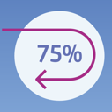

5G and Edge for Smart Communities
CEF-DIG-2024-5GLSP-SMARTCOM-WORKS: 5G large scale pilots
5G and Edge for Smart Communities – Works
Scope - Eligible costs
Passive and active connectivity elements, required to implement innovative use-cases (including edge-cloud)
5G radio equipment
Backhaul, yet not the major focus (< about 10%)
Individual applications, internet software services; end-user devices, connectivity subscriptions
For specific questions
HADEA-CEF-DIGITAL-CALLS@ec.europa.eu
Reimbursing up to 75% of the infrastructure costs

Slide 41

5GSC Community Support Platform
Make sure to join the 5GSC Community Support Platform: 5GSC.eu
The platform is a networking & knowledge-exchange online platform where you can:
  Meet like-minded stakeholders & project partners
  Share good practices
  Stay up to date with 5G events
  Get information on call openings

Slide 42
EuroQCI
Katie LOW
Policy Officer,
Unit C.4, Emerging & Disruptive Technologies
DG CONNECT, European Commission

Slide 43


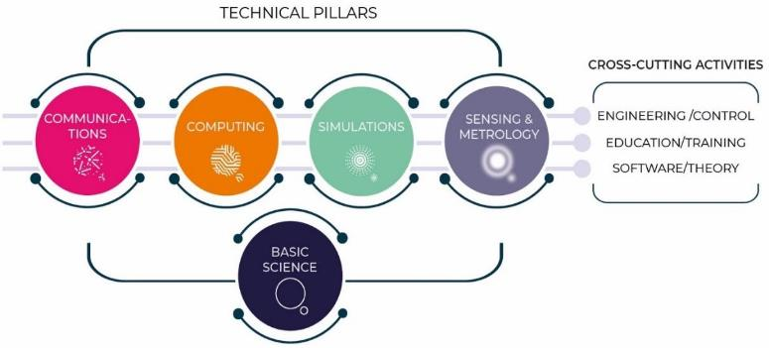




Strategic pillars of the EU quantum ecosystem
Skills & Education
IRIS² & EuroQCI
Chips Act
Quantum Chips
Equity Investments
& Support to Start-ups
Sensing Infrastructures
Space Gravimetry

Slide 44

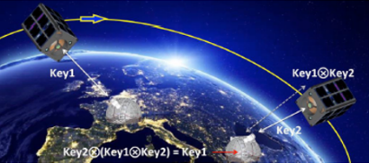

EuroQCI: overview
Integrated satellite and terrestrial system spanning the whole EU
for ultra-secure exchange of cryptographic keys (Quantum Key Distribution)
Part of the EU Cybersecurity Strategy and integrated into IRIS²,
the Union Secure Connectivity Programme (Regulation (EU) 2023/588)
Space segment
Distribution of quantum-secured encryption keys on a global scale
Terrestrial segment
Federation of national terrestrial QCI networks with cross-border connections
https://digital-strategy.ec.europa.eu/en/policies/european-quantum-communication-infrastructure-euroqci

Slide 45
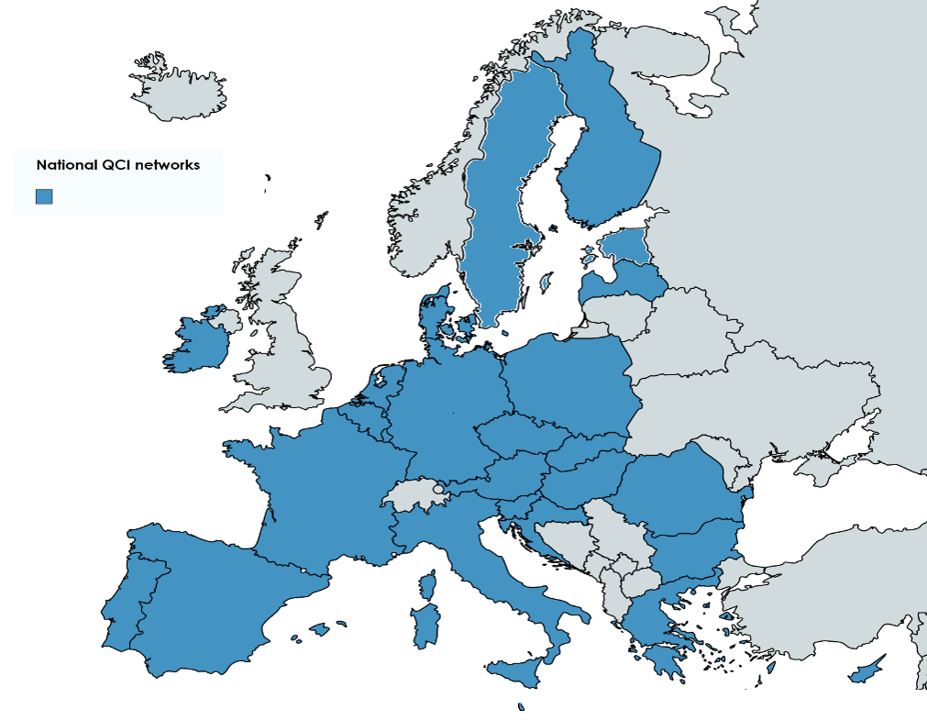
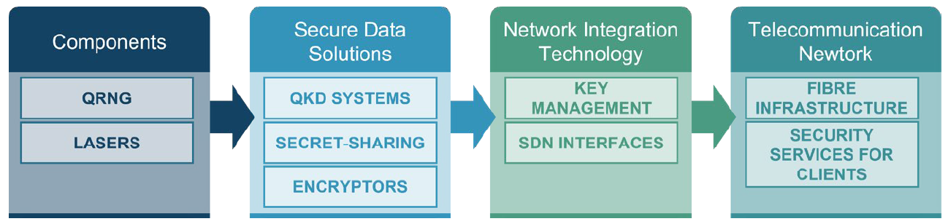
EuroQCI terrestrial state of play
26 Member States deploying national QCI networks (2023-2025)
  Started on 1 January 2023, 30+ months
  Initiate MS to QKD use, mature skills, test architecture, develop use cases, prepare for full deployment
6 industry projects maturing EU QCI technologies (2023-2025)
  QKD systems ready for integration into telecommunication networks
  QKD modules (QRNG, optical component), key management software, encryptors. QKD protocols (CV-QKD and MDI-QKD)
Procurement of a European testing and evaluation infrastructure (2024-2028)
Cross border & deployment of optical ground stations (to synchronise with Eagle 1) to start in 2026 - CEF call
Notes:
Explain whay we want to achieve the Quantum Internet (intefration of sensors, Q computers)
QSNP developes QKD technology to feed EuroQCI

Slide 46

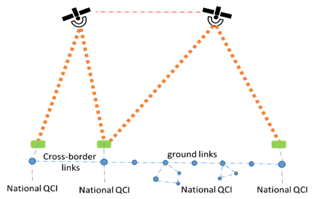
European Quantum Communication
Infrastructure (EuroQCI)
Deployment of the first cross-border quantum terrestrial backbone networks for interconnecting neighbouring national quantum communication infrastructures, including if necessary through the deployment of "trusted nodes"
interconnection with the EuroQCI’s space segment, via optical ground stations
Where relevant, fibre links between the EuroQCI and a pan-European network of Security Operation Centres (SOCs)
This includes the actions needed to manage encryption keys efficiently and securely in an end-to-end manner and ensure their transmission to recipients
Projects should normally be up to 42 months
Indicative grant amount: EUR 5 million, basic funding rate 30% but 50% for projects with strong cross-border dimension including the space segment

Slide 47
EuroQCI – points to note
Restriction to entities established, or deemed to be established, in Member States and directly or indirectly controlled by Member States or by nationals of Member States (Art. 11(4) of CEF Regulation): ownership and control assessment will be carried out (no exceptions possible, e.g. via guarantees)
Critical components for QKD should use EU technologies if available; the use of non-EU technologies must be justified
No ‘durability’ requirement (maintenance of infrastructure for five years after end of project)
CEF Regulation does not allow research to be financed (but studies eligible)
Proposals to undergo security scrutiny (identify security concerns and use of classified information, propose mitigation measures if necessary)
Access to necessary information via call document:
  Specifications related to OGS and ground equipment for connecting with Eagle 1
  Specifications necessary for OGS compatibility with SAGA

Slide 48
Application Process
Karina MARCUS
Project Adviser,
European Health and Digital Executive Agency (HaDEA)

Slide 49

HaDEA
Health and Digital Executive Agency

Slide 50
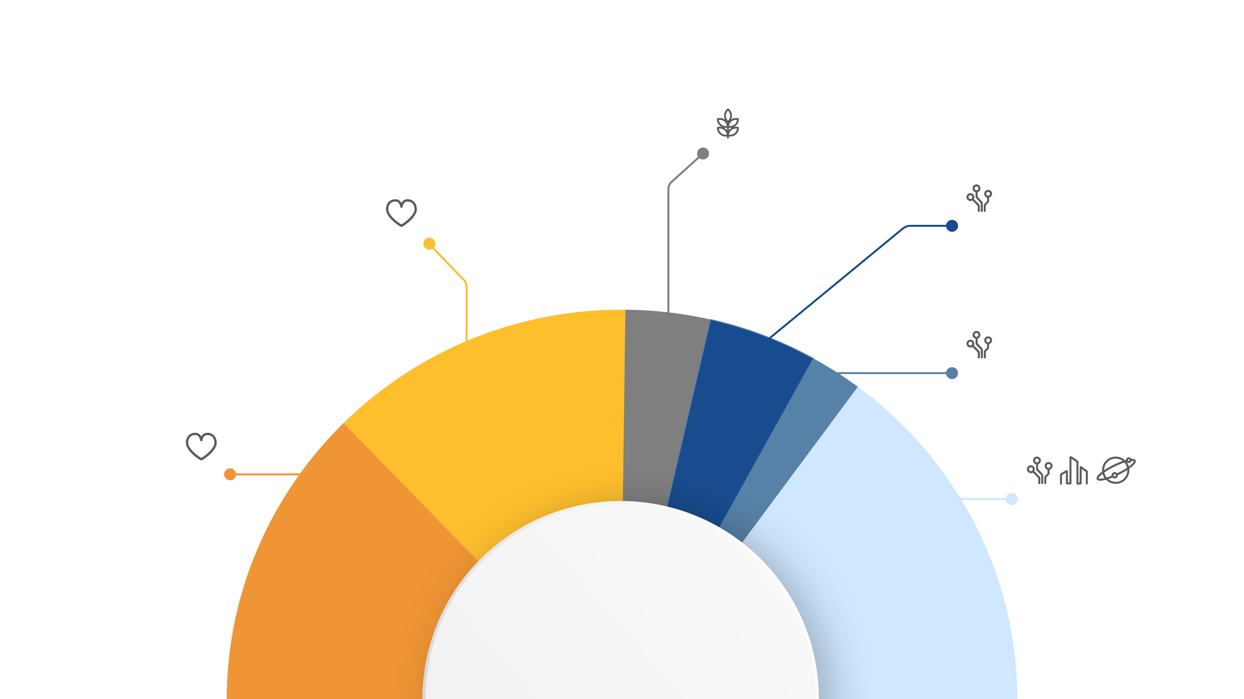
HaDEA implements
EU Programmes (2021-2027)
CINEA implements:
CEF-Energy | € 5.8 billion
CEF-Transport | € 25.8 billion
Single Market Programme
Food safety
€1.3 billion
Connecting Europe Facility (CEF)– Digital
€1.6 billion
EU4Health
€4.7 billion
Digital Europe
€0.8 billion
Horizon Europe
Health cluster
€5.4 billion
Horizon Europe
Digital, Industry
& Space cluster
€5.6 billion
HaDEA implements
Notes:
Ask your questions in the chat

Slide 51
Overview of CEF-Digital calls 2024 (Call-4)
Calls | Topics | Budget (M EUR)
5G Large Scale Pilots | 5G Coverage along Transport Corridors CEF-DIG-2024-5GLSP-CORRIDORS-WORKS 5G & Edge for Smart Communities CEF-DIG-2024-5GLSP-SMARTCOM-WORKS | 105
Backbone connectivity for Digital Global Gateways | CEF-DIG-2024-GATEWAYS-WORKS CEF-DIG-2024-GATEWAYS-STUDIES | 128
EuroQCI | CEF-DIG-2024-EUROQCI-WORKS | 90
TOTAL |  | 323
Notes:
-> expected to be increased! To be rev

Slide 52
Call-4: Indicative Timeline
Call opening | 22 October 2024
CEF Digital Information Day | 12 November 2024
Call Closing | 13 February 2025 17:00 (CET)
Evaluation & Selection of proposals | Febr. – Sept. 2025
Information to applicants | August 2025
Grant agreement preparation & signature | August – Nov. 2025

Slide 53
Evaluation Process and Award Criteria

Slide 54
Evaluation of Proposals
Preliminary
Checks
(HaDEA)
Admissibility
check
Eligibility
check
External
Evaluation
(Indep. Experts)
Individual
assessments
Internal
Evaluation
(Europ. Commission)
Recommended draft list of proposals
Consensus
meeting
Other assessments: ownership & control, security compliance declaration, security scrutiny, financial & operational capacity, etc.
Selection
Committee
February 2025
March – May 2025
June - July 2025

Slide 55
Final Selection Process
Consultation of European Commission Directorates-General
(Inter-Service Consultation)
Consultation of Member States
(CEF Programme Committee)
Grant Agreement Preparation (GAP)
Grant Agreement Signature
Commission Selection Decision
June – July 2025
Information to Applicants: unsuccessful / successful
August – November 2025

Slide 56
Admissibility
Proposals must be submitted:
by the call deadline, i.e. 13 February 2025, 17:00 CET (Brussels time);
through the Funding & Tenders (F&T) Portal;
NB: paper or e-mail submissions are NOT possible.
readable, accessible and printable;
and complete, i.e. include all documents and mandatory annexes.
NB: use the templates provided in the Submission System.

Slide 57
Admissibility – lessons learnt
Part A: inconsistencies of budget figures (online) vs detailed budget per Work Package
Part B: missing parts in application form –> check pdf file before uploading!
Part C: KPI information (for Works proposals) is incomplete/inconsistent with other parts of the application
Mandatory annexes (as per call text):
  Missing self-declarations, letters, etc. because the F&T Portal “allows” submitting the proposal without them –> always check section 5 of the call text !
  Member State agreement not signed (letter of support).
  Missing agreements from other concerned Member States, i.e. those benefitting from the project (not just the Member States of applicant entities); this is required for both Works or Studies applications.
  Incomplete security declarations –> templates available in 2024 calls

Slide 58
Eligibility - Lessons learnt
Proposal is ‘out of scope’ under the topic submitted
Applicants do not fulfil the minimum consortium composition (if required by call conditions)
  Pay attention to the type of participants in the consortium! “Affiliated entities” and “Associated Partners” do not count towards minimum consortium composition.
Affiliated entities: entities with a legal or capital link to a beneficiary which participate in the project with similar rights and obligations as the beneficiaries, but do not sign the grant.
Associated partners: partner organisations which participate in the project but without the right to get funding.

Slide 59
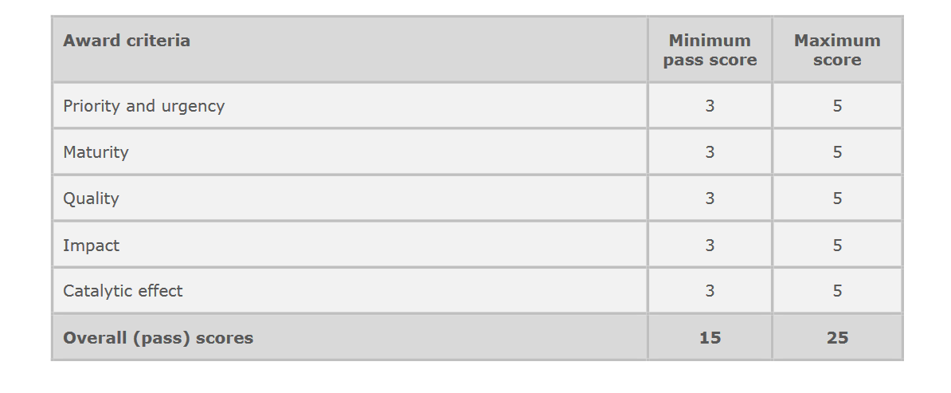
Award criteria

Slide 60
Results of the evaluation
All proposals are ranked and receive an evaluation result letter stating that they are either:
  successful & invited for grant agreement preparation (GAP);
  successful, but put on reserve list (passed mark but below budget availability)
  -> Seal of Excellence;
  rejected (insufficient quality).
Invitation to grant agreement preparation does NOT constitute a formal commitment for funding. We will still need to make various legal checks before grant award: legal entity validation, financial capacity, ownership control assessment, etc.
If you believe that the evaluation procedure was flawed, you may submit a complaint (deadlines and procedures set out in the evaluation result letter).

Slide 61
Preparing a successful proposal

Slide 62
Quality of proposal (I)
Who will read your application?
External evaluators:
  Their individual expertise may not cover the entire technical background of your proposed project
  They will have several proposals to evaluate within a limited timeframe
EC staff:
  HaDEA: to check the proposal’s admissibility & eligibility
  DG CNECT: an internal committee will recommend a draft list of selected proposals

Slide 63
Quality of proposal (II)
What is the reader looking for?
  Simple language: avoid jargon and do not take any background knowledge for granted.
  Information easy to find: demonstrate how your proposal addresses the award criteria as indicated in the call text.
    The evaluation of your proposal is based on the content you provide in the application form; be as specific and clear as possible.
    No assumptions, nor requests for additional information will be made.
  Mandatory annexes.
  Voluntary annexes: relevant maps, graphs, etc.
Notes:
To be able to assess/evaluate the proposal

Slide 64
Quality of proposal (III)
Project’s Scope (1/2)
What
Why / Results
What is the project about?
  Ex: Inception Study, preparation of permitting documents, …
What are the project’s technical parameters?
  Ex: 5G coverage in Km, length of submarine cable, data transfer rate between cloud nodes, …
What are the expected results of the project?
  Ex: use-case supporting of schools, mobility enabled on a specific corridor, final procurement documents prepared, approval of permitting documents, etc.

Slide 65
Quality of proposal (IV)
Project’s Scope (2/2)
How
Who
How will the project's objectives be reached?
  Work Packages, Tasks, Milestones, Deliverables, Resources, …
Who will carry out the project?
  Ex: all tasks of the project will be carried out by internal and external resources.
  Subcontracting per Work Packages (Procurement aspects)

Slide 66
Quality of proposal (V)
Work Packages
Tasks, Deliverables and Milestones
What
A Work Package (WP) is a major subdivision of the project into Tasks
What are the objectives of the WP?
  Ex: commissioning of cable, preparing documentation
Clear WP name matching its description.
  Ex: Detailed Design and Tender Documents, Deployment of cable
What are the tasks in the WP?
  Ex: construction and acceptance tests of the facilities, supervision of the construction
What are the deliverables?
  Ex: analysis of the service requirements, report on the completed deployment works
What are the milestones?
  Ex: Selected service provider for deployment, 60% of the deployment of the cable completed
Notes:
“lower” level + to give examples
Milestones: about process
Deliverables: about con
Milestone: major control points in the project that help to chart progress
Ex: publication of a tender, signature of contract, start of study/works
Deliverable: project output (may not be linked to Milestones)
Ex: documentation for the network plans, engineering design, commissioning of the passive network elements
tent

Slide 67
Contact us
Questions on the CEF-Digital calls should be sent to
HADEA-CEF-DIGITAL-CALLS@ec.europa.eu
For IT/technical issues on the Portal Submission System,
questions should be sent to IT Helpdesk
Take some time to fill in the short feedback survey in the streaming page!
Notes:
Remember to mention the survey!

Slide 68




For more information go to
CEF-Digital Information Day
Thank you!
hadea.ec.europa.eu
HaDEA – European Health and Digital Executive Agency
@EU_HaDEA
© European Union 2020
Unless otherwise noted the reuse of this presentation is authorised under the CC BY 4.0 license. For any use or reproduction of elements that are not owned by the EU, permission may need to be sought directly from the respective right holders.
HADEA-CEF-DIGITAL-CALLS@ec.europa.eu

Slide 69

QUESTIONS?

Slide 70
Thank you

